Slide 1
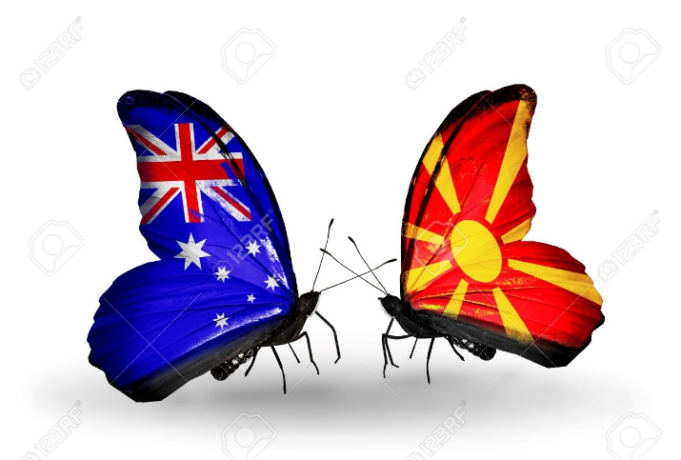
MACEDONIAN COMMUNITY OF WA (INC)
MACEDONIAN COMMUNITY LANGUAGE SCHOOL
ШКОЛО ЗА МАКЕДОНСКИ JAЗИК

Slide 2
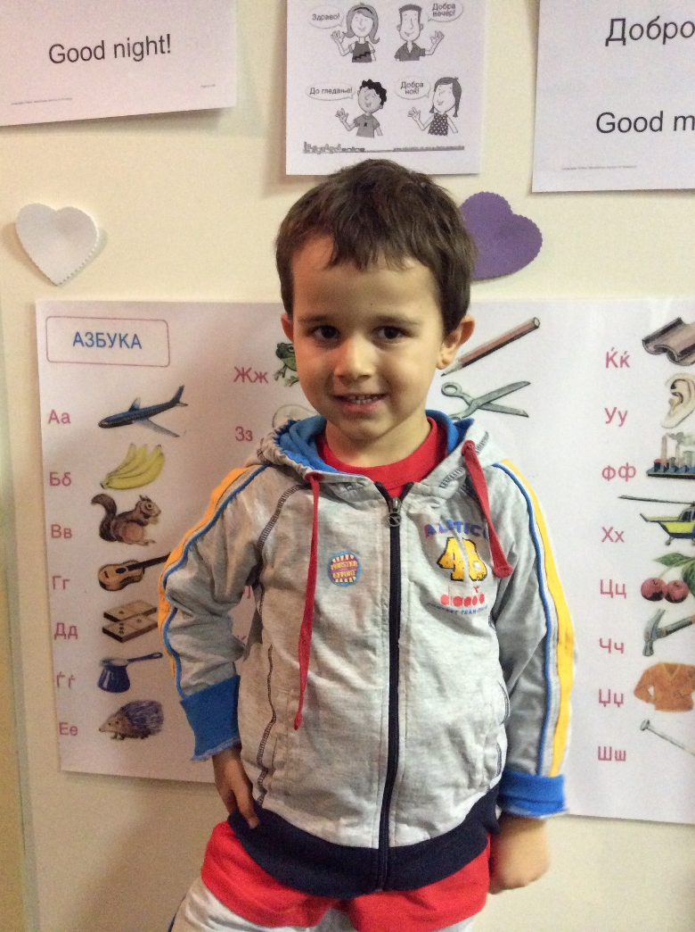
Overview
Established in 2012
Largest single provider of Macedonian language in Western Australia
Aims to provide Macedonian language and culture to all individuals
Established on strong partnerships with students and their families
Classes operate from the Macedonian Community Centre of Western Australia
Classes operate after hours. Classes are not held during school holidays, on public holidays or on long weekends when a public holiday falls on a Saturday or Monday.

Slide 3
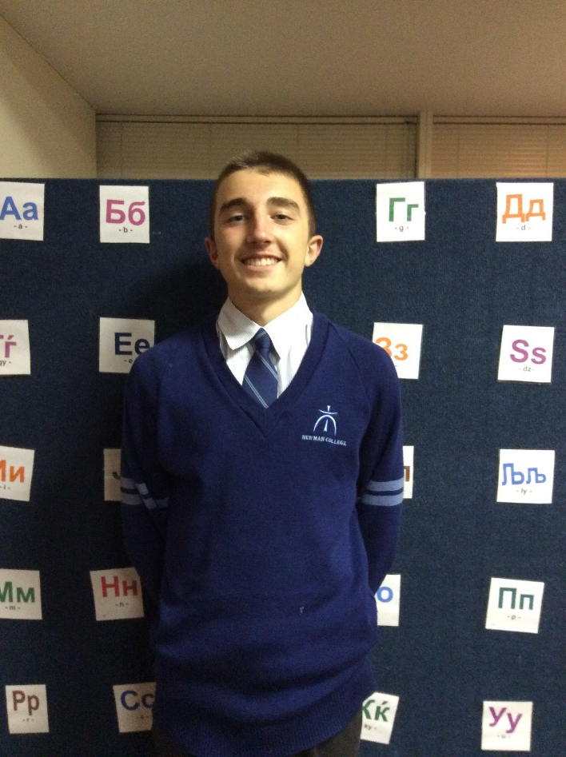
School Structure
School Board
Provides strategic advice to ensure the effective operation of the Macedonian Community Language School.
Meets quarterly
Representation comprises 8 members
Planning Committee
Establish annual business plan
Meets annually
Representation comprises Board members, teachers, students and teaching practitioners.
Classes
Kindergarten to Year 12 Class
Senior Classes
Short Term Courses

Slide 4
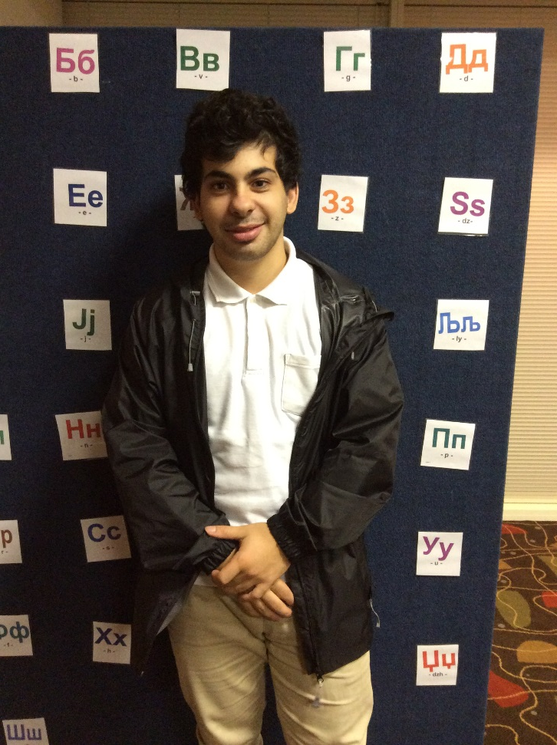
Curriculum
Kindergarten to Year 12
Consistent course outline with other Australian States who deliver Macedonian language
Cultural understandings are embedded in the language course outline, including music, songs and stories
The course outline also provides practical opportunities to use the Macedonian language in associated Community events
Foundational Macedonian
Students 17 years and older
Develop an understanding of the history and structure of the Macedonian language.
Students learn to speak, read and write Macedonian

Slide 5
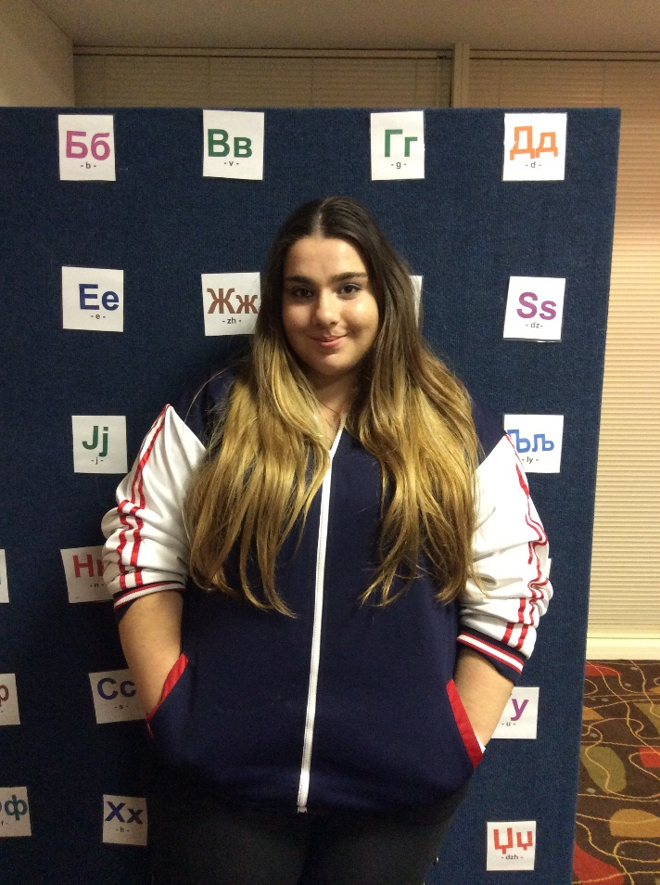
Curriculum (Cont.)
Advanced and Conversational Macedonian
Students 17 years and older
Already have basic ability to read, write and speak Macedonian
Builds on the Foundational Macedonian program
Enhances the use of Macedonian language through conversation, literature and cultural sources

Slide 6

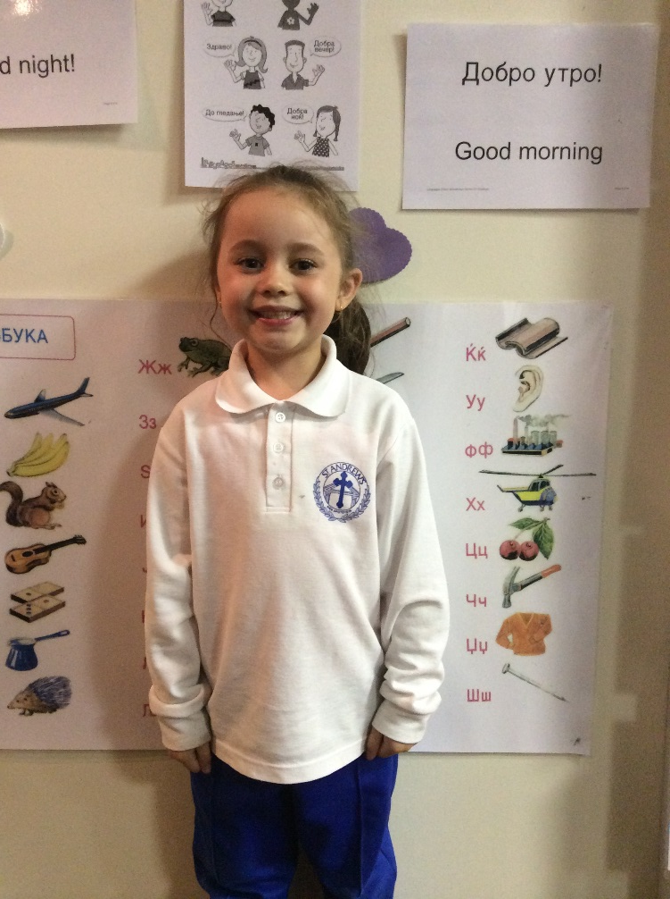
Teaching Arrangements
Monday – Kindergarten to Year 12
  Level 1 (Ages 5 to 10) – Breanna Manov
  Level 2 (Ages 11 to 17) – Jovanka Jakovceska
Tuesday - Foundational Macedonian – John Ailakis
  For students who have no or little knowledge of the Macedonian language
Thursday - Advanced and Conversational Macedonian – John Ailakis
  For students who have the ability to read and write Macedonian at a basic level.
Relief teachers: Vasko Kamchev and Natasha Naumovski

Slide 7
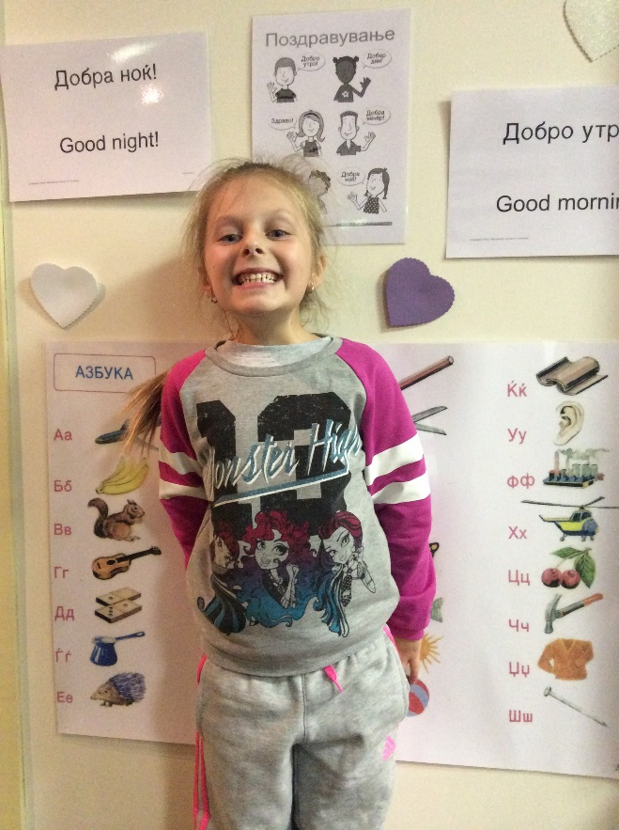
Breanna Manov
K-12 – Level 1 (Junior Group)
Students participating in the first phase of learning should generally be able to:
repeat teacher-modelled use of the language
participate in choral use of the language
identify the names of visible objects and items from visual cues
introduce themselves, greet and farewell the teacher
follow simple classroom directions
notice and discuss the different writing system, and practise writing individual letters and other symbols
distinguish selected letter sounds from English, match sounds and letters, identify words for concrete items from cues, etc.
copy or trace selected letters and match them to sounds and words.

Slide 8
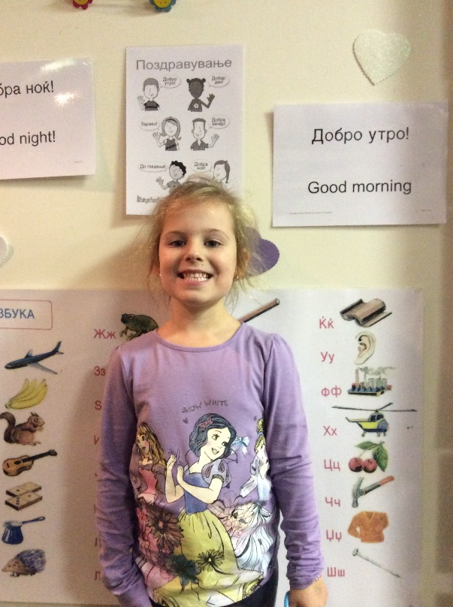
  Jovanka Jakovceska
K-12 – Level 2
Students participating in this course acquire two dimensions of key knowledge and skills:
how to communicate in Macedonian; and
obtain intercultural knowledge and language awareness.
Skills such as:
listening, speaking, reading, viewing and writing.
vocabulary and grammar; and
familiarity with a wide range of texts in Macedonian.
connection between language and culture and how culture is embedded in language;
awareness of the influence of culture in their own life and their first language, English.
knowledge of cultural traditions.
Themes for this year include Sports, Transport, Leisure Activities, Shopping, Food, Animals, In the classroom and I am feeling.

Slide 9
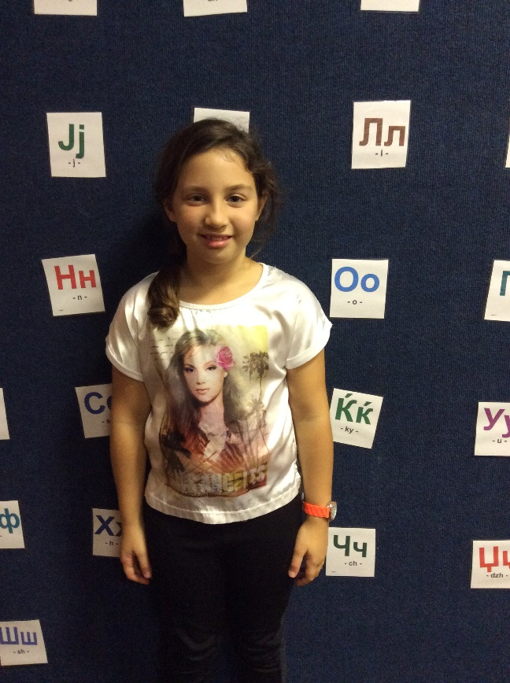
  Jovanka Jakovceska
  K-12 – Level 2 (Cont.)
Студентите кои учествуваат во овој курс се стекнуваат со две димензии на клучно
знаење и вештини:
Како да комуницираат на Македонски јазик; и
добиваат инеркултурно знаење и свесност за јазкикот.
Вештините како што се:
слушање, зборување, читање, гледање и пишување;
речник и граматика;
запознавање со широк обем на текстови на Македонски јазик;
поврзаноста на јазикот со културата и како културата е вткаена во јазикот;
свесност за влијанието на културата во нивниот живот и нивниот прв јазик, Англискиот; и
запознавање со културните традиции.
Темите за оваа година вклучуваат: Спорт, Транспорт, Слободни активности, Пазарење (купување), Храна, Животни, Во училницата и Јас чувствувам.

Slide 10
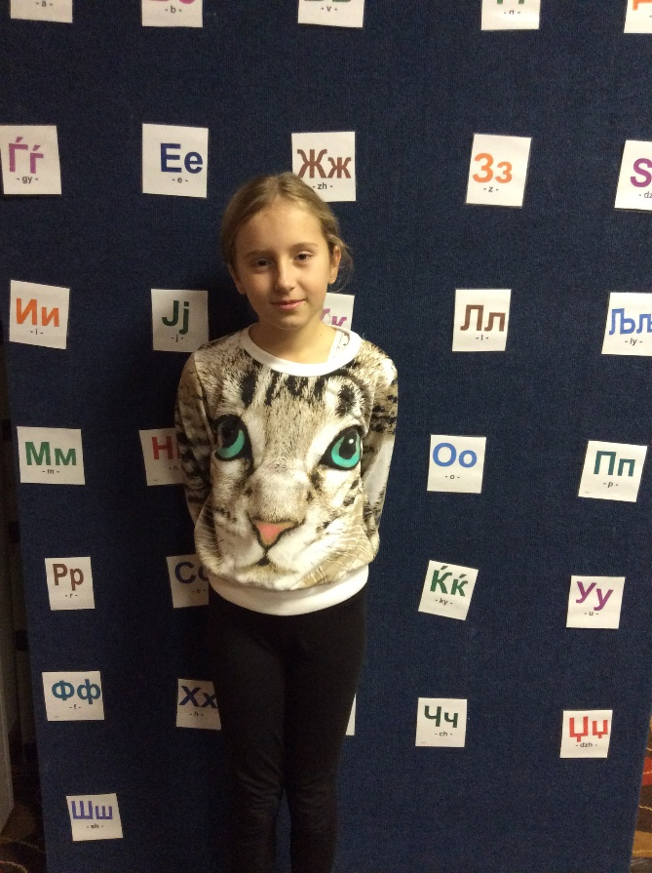
John Ailakis
Foundational Macedonian
Who is it aimed at?
За кој е?
For those with little or no knowledge of Мacedonian.
За тие што немаат, или имаат малку, разбирање на македонскиот јазик.
What are the goals of the course?
Што се целите на курсот?
1. To be able to read and write Macedonian Cyrillic.
1. Ќе можат да пишуваат и читаат по македонски.
2. To have a basic understanding of the structure of Macedonian.
2. Да имаат основен разбирање на структуата на македонскиот јазик.

Slide 11
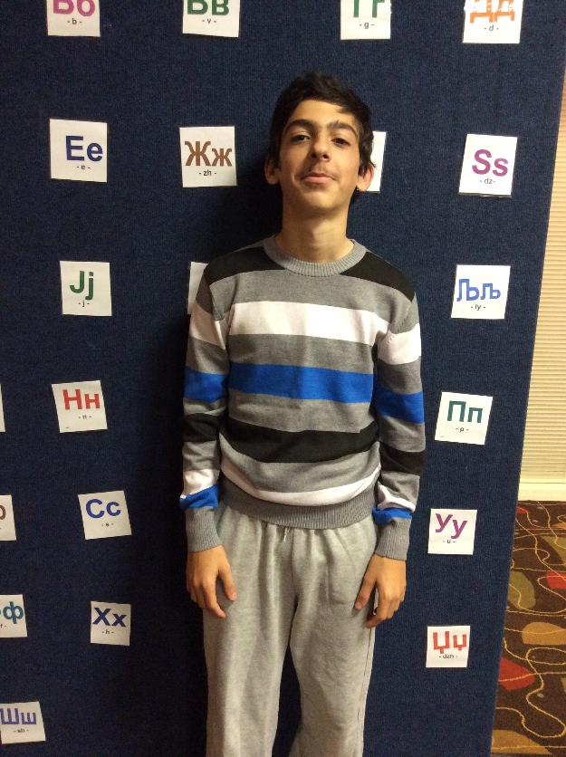
John Ailakis
Foundational Macedonian (Cont.)
3. To be able to engage in simple Macedonian conversation.
3. Ќе можат да се вклучат во едноставен разговор по македонски.
What are the techniques we use?
Што се техниките што ги користиме?
Professional textbook
Spoken exercises
Games
Audio-visual material (and more …)
Професионален учебник
Вежби со зборување
Игри
Аудио-Визуелни материјали (и повеќе ...)

Slide 12
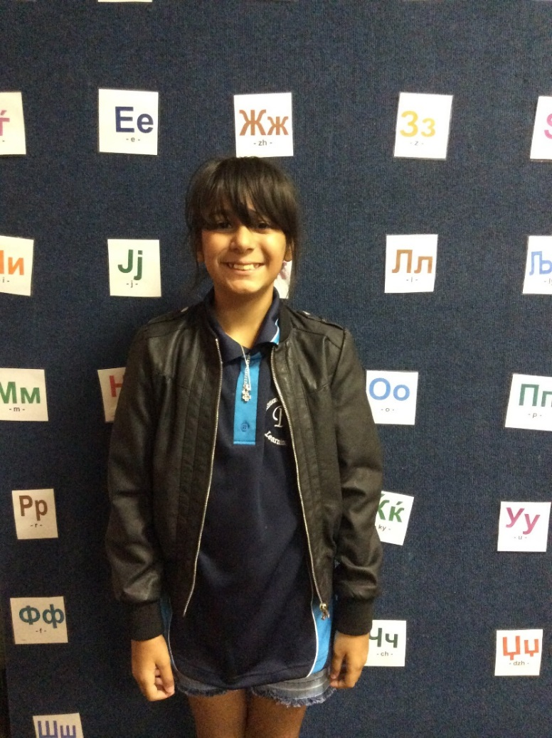
Parent Participation
Reading Roster
Volunteers
School Board
Performances/Family Evenings
Fund Raisers
Administration and Secretariat Role

Slide 13
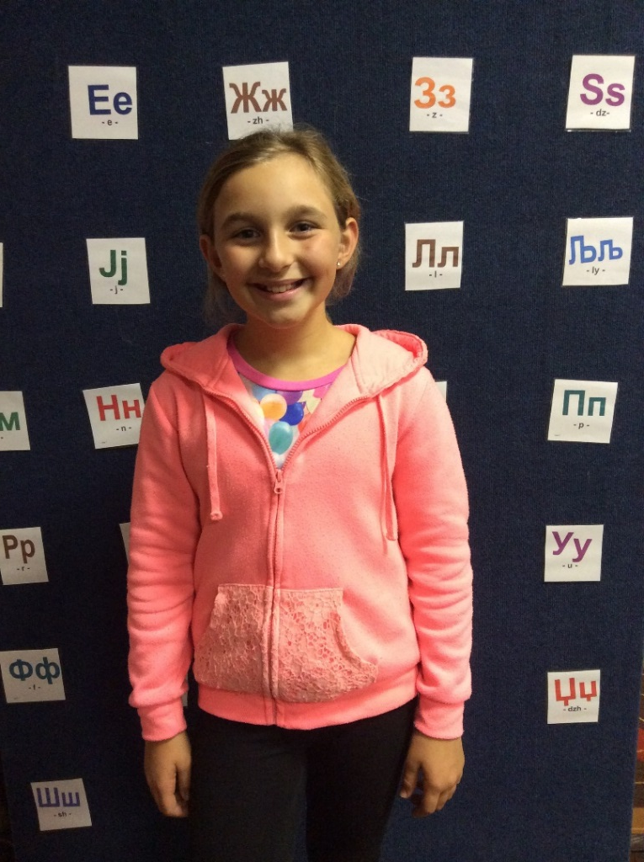
Parent Communications
Newsletters
Website – www.macedoniawa.com.au
Facebook - https://www.facebook.com/MacedonianCommunityWA
Parent Information Night
Radio – 95.3 6EBA FM, 103.3 MAK FM
Assessment and Student Reporting
Directly with teachers before or after class
Contact with Director via email on language@macedoniawa.com.au
Phone 9328 7852

Slide 14

